Slide 1

Data Frames, Usage of frames analytical roles,
Sit Dolor Amet

Slide 2


Slide 3

What is Pandas
Pandas is a Python library used for working with data sets.
It has functions for analyzing, cleaning, exploring, and manipulating data.
The name "Pandas" has a reference to both "Panel Data", and "Python Data Analysis

Slide 4
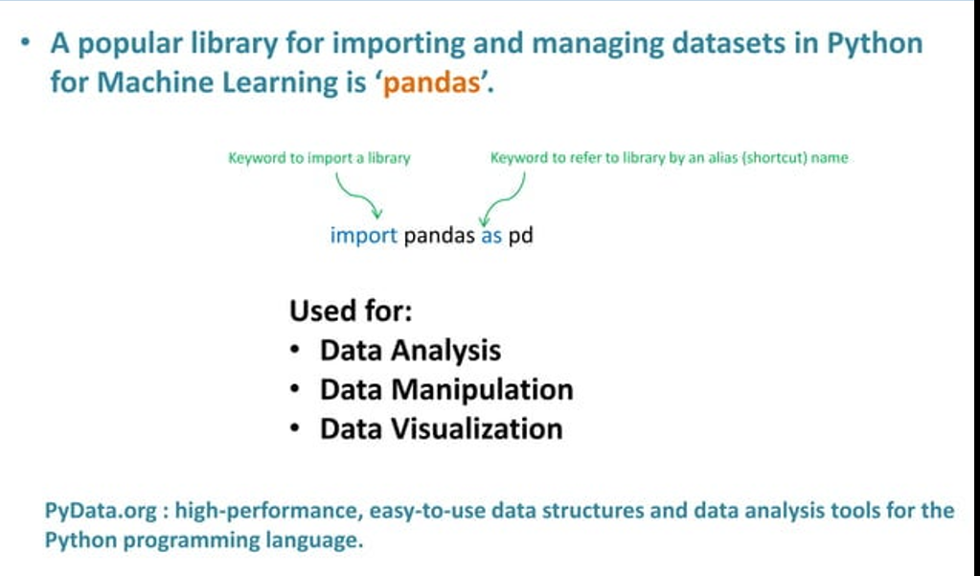

Slide 5

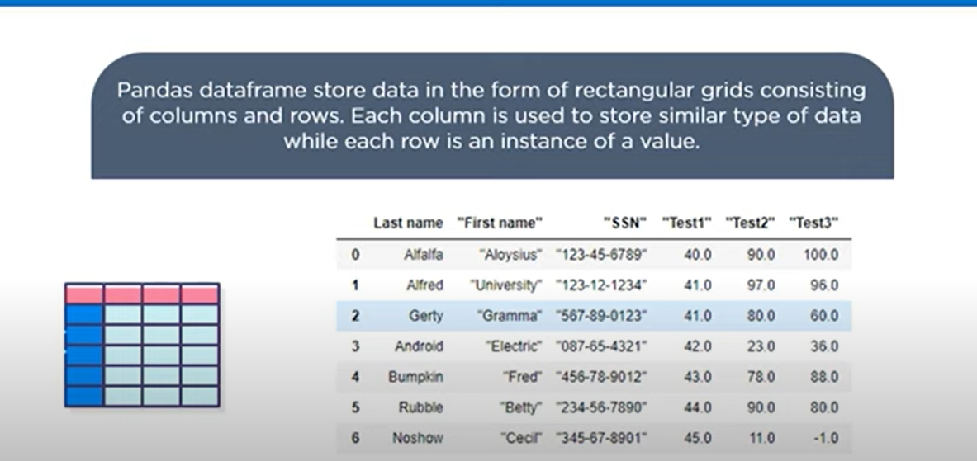

Slide 6
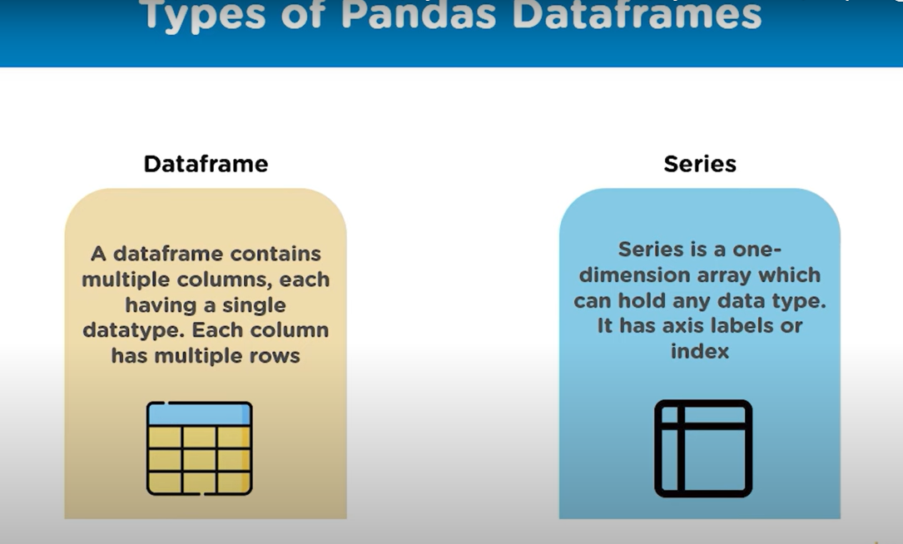
Series vs Dataframe
Series: A Series is a one-dimensional labeled array that can hold any data type (integer, string, float, etc.).
Think of it as a column in a spreadsheet or a single column in a database table.
Each element in a Series has an
associated index, which allows for quick access to data.
DataFrame: A DataFrame is a two-dimensional labeled data structure with columns of potentially different types.
It can be thought of as a spreadsheet or a SQL table, or a dictionary of Series objects.
A DataFrame can store multiple columns of data, each of which can be accessed using column labels.

Slide 7
A data frame is a two-dimensional data structure that organizes data into a table of rows and columns. It's similar to an Excel spreadsheet or database, and is often used in data analytics because it's flexible and intuitive. Data frames are the main data type in several programming languages, including:
Python: In Python, a data frame is an object in the pandas library. It's made up of a dictionary of lists, where each list has its own identifier or key. For example, a key might be "last name" or "food group". Data frames are automatically indexed 0 to n, where n is the number of values in the dictionary.
https://www.hackerearth.com/practice/machine-learning/data-manipulation-visualisation-r-python/tutorial-data-manipulation-numpy-pandas-python/tutorial/
https://www.kdnuggets.com/10-essential-pandas-functions-every-data-scientist-should-know
https://drive.google.com/file/d/1GdNHSVa0MYDPXJ0yR1H9N-v6uUczh22F/view?usp=sharing

Slide 8
Data Frame data types
6
Pandas Type | Native Python Type | Description
object | string | The most general dtype. Will be assigned to your column if column has mixed types (numbers and strings).
int64 | int | Numeric characters. 64 refers to the memory allocated to hold this character.
float64 | float | Numeric characters with decimals. If a column contains numbers and NaNs(see below), pandas will default to float64, in case your missing value has a decimal.
datetime64, timedelta[ns] | N/A (but see the datetime module in Python’s standard library) | Values meant to hold time data. Look into these for time series experiments.
www.bennett.edu.in

Slide 9
Difference between loc and iloc
loc (Label Location)
Indexing Method: Uses label-based indexing, meaning
it selects data based on the labels (index names)
of the rows and columns.
Syntax: df.loc[row_label, column_label]
Usage: Useful when you want to access data by the actual labels (names) of the rows and columns.
iloc (Integer Location)
Indexing Method: Uses integer-based indexing
, meaning it selects data based on the numerical position (index) of the rows and columns.
Syntax: df.iloc[row_index, column_index]
Usage: Ideal when you want to select rows and columns by their integer position.
import pandas as pd
data = {'A': [1, 2, 3], 'B': [4, 5, 6], 'C': [7, 8, 9]}
df = pd.DataFrame(data)
# Access the element in the 2nd row and 3rd column (0-based index)
value = df.iloc[1, 2] # Output: 8
import pandas as pd
data = {'A': [1, 2, 3], 'B': [4, 5, 6], 'C': [7, 8, 9]}
df = pd.DataFrame(data, index=['x', 'y', 'z'])
# Access the element in the row with label 'y' and column 'C'
value = df.loc['y', 'C'] # Output: 8
https://colab.research.google.com/drive/1fl2KEG51Pt-8LJmbbNgm88SE94OVLBaK?usp=sharing

Slide 10
Grouping, Sorting and Filtering Data
Sorting Techniques in Pandas DataFrame
Sorting by Single Column
Sorting by a single column is the most common sorting technique. It arranges the rows of the DataFrame based on the values in a single column. For example, we can sort a DataFrame of students based on their grades in ascending or descending order.
Sorting by Multiple Columns
Sorting by multiple columns allows us to sort the DataFrame based on multiple criteria. For example, we can sort a DataFrame of employees based on their salary and age.
Sorting in Ascending Order
Sorting in ascending order arranges the data from the smallest value to the largest value. It is the default sorting order in Pandas DataFrame.
Sorting in Descending Order
Sorting in descending order arranges the data from the largest value to the smallest value. It can be useful when we want to find the top or bottom values in the data.
https://pandas.pydata.org/docs/reference/api/pandas.DataFrame.sort_values.html

Slide 11
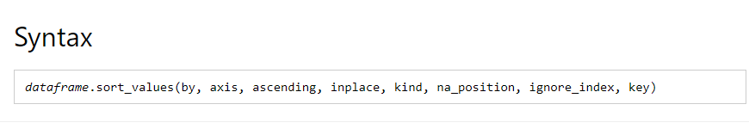
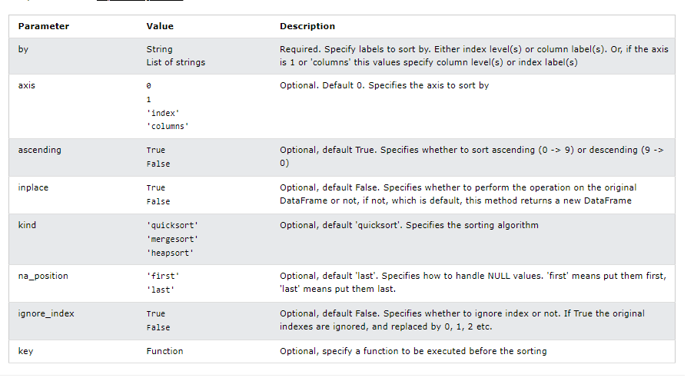
Sorting

Slide 12

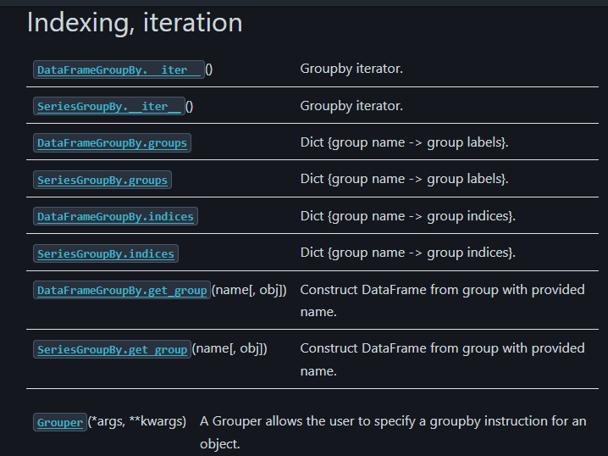
Groupby

